Slide 2
2022 BHS Tennis Kickoff Meeting
January 19, 2022

Slide 3
Agenda
Welcome Ivan Asteghene
Brookwood Racquet Club Introduction BHS Racquet Club Board
Team News and Information Coach Daniel Bowles and Coach Rachel McElroy
Paperwork and Spirit Wear BHS Racquet Club Board

Slide 4
2022 Board
President Ivan Asteghene
Vice President Jim Herren
Vice President Cristy Williams
Treasurer Pete Fox
Secretary Kat Hamilton
Member-at-Large Uma Shankar

Slide 5
2022 Board Leaders
Team Parents Kat Hamilton
Spirit Wear and Uniforms Ivan Asteghene
Digital Uma Shankar
Bronco Aces Ivan Asteghene
Sponsorships Uma Shankar
Fundraising Coordinator Uma Shankar
Banquet Cristy Williams

Slide 6
Our Mission
Provide financial support for BHS Tennis program
(10 State Championships, 46 Region Championships)
Develop community outreach programs for the long-term benefit of BHS Tennis
Promote BHS Tennis and our student-athletes
Provide operational support for coaches and administrators

Slide 7
Parent/Player Expectations
Support of coaches, players and parents
Understanding tennis at Brookwood is a team sport
Time
Transportation to matches
Match support
Bronco Aces
Program promotion
Financial | program is funded through parents and sponsors (no ticket sales!)

Slide 8
Budget | Overview
2022 Priorities
Allow BHS Tennis players to represent our school and community with confidence
Brookwood Racquet Club Bill Shields Scholarship ($1000 per gender)
Tournament opportunities
Invest in current year operating budget
Carryover enough funds to prepare pre-season 2023
Pay JV Coaching Stipends
Fund Incentive Bonuses to coaches

Slide 9
Expectations – Financial
 | Boys Varsity | Boys JV | Girls Varsity | Girls JV
Mandatory
Player fee | $390 | $325 | $390 | $325
Sponsorships (Due tonight) | $100 | $100 | $100 | $100
Subtotal: | $490 | $425 | $490 | $425
Expected
Spirit Wear | $100 | n/a | $100 | n/a
Grand Total: Due by February 4, 2022 | $590 | $425 | $590 | $425

Slide 10
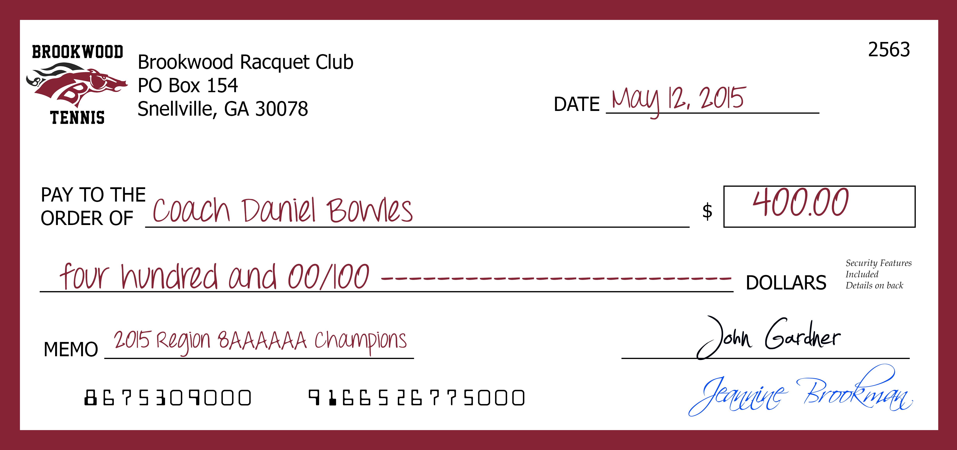
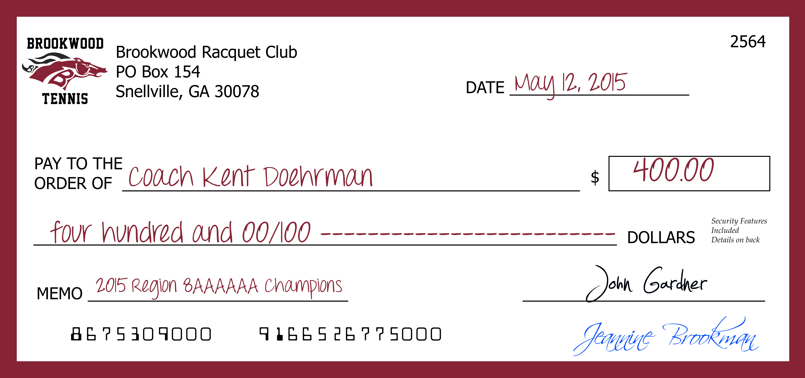
Budget | Additional Expenses
Brookwood High School Racquet Club coaches bonus
Championship Level | Bonus
Region Championship | $200
Final 8 | $200
Final 4 | $250
Finals | $300
State Championship | $1,000
POSSIBLE | $1,950

Slide 11
Sponsorships
Opportunity for all companies and organizations to participate
Multiple levels
Bronco - $500
Maroon - $300
Gold - $200
White - $100
Tax deductible BHS Racquet Club is 501c(3)

Slide 12
Family Sponsorship
Minimum $100 obligation per player due tonight
Payment of $300 Corporate Sponsorship
Offset options (Note: check can be cut by treasurer)
Minimum obligation can be offset by securing a minimum $300 Corporate Sponsorship or through individual fundraising opportunity (As described in next slide)

Slide 13
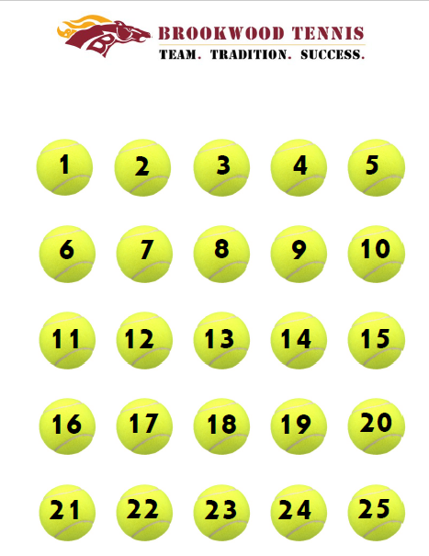
Individual Fundraising Opportunity

Slide 14
Operating Budget Fundraiser (Bronco Aces)
Supports our community development
Three Sunday sessions (based on age groups) per day
3/6, 3/20, 3/27 (Rain Date TBD) $30 per child
Coordinated by Ivan Asteghene
Led by our own Players improving Peer Leadership
Players required to support during the event
80+ kids in 2020 from K - 8th

Slide 15
Spirit Wear
Spirit wear – pictures of items on website
Order form is available on website under BHS Racquet Club tab
Please refer to Order Form for ordering deadlines. We have a very quick turnaround for the orders so we can get items back before the end of the season.

Slide 16
Coach McLane and Coach McElroy
2022 Bronco Tennis

Slide 17
2022 Coaching Staff
VARSITY BOYS Coach Ben McLane
VARSITY GIRLS Coach Rachel McElroy
JUNIOR VARSITY BOYS Coach
JUNIOR VARSITY GIRLS Coach

Slide 18
Team Introductions
Coaches

Slide 19
2022 Brookwood Boys Junior Varsity
Player | Grade

Slide 20
2022 Brookwood Girls Junior Varsity
Player | Grade
Kayla Widy | 11
Olivia Jaime | 11
Lauren Sams | 10
Ashlyn Isenhour | 9
Hannah Moore | 9
Isabel Sanchez | 9
Nicole Khatchadourian | 9
Olivia Hamilton | 9
Riley Reed | 9

Slide 21
2022 Brookwood Boys Varsity
Player | Grade
Teo Asteghene | 11
Evan Burnley | 11
Skylar Ewe | 10
Dillon Grose | 10
Rishi Krishnamurthy | 11
Raymond Liu | 11
Kapil Shankar | 10
Matthew Xu | 10

Slide 22
2022 Brookwood Girls Varsity
Player | Grade
Jenna Herren | 12
Kristian Patterson | 12
Kyla Wallace | 12
Saxon Williams | 11
Shayda Torab | 10

Slide 23
2022 Home Courts
VARSITY BOYS Montclair
VARSITY GIRLS Bright Water and River Oaks
JUNIOR VARSITY BOYS AND GIRLS Brookwood Manor

Slide 24
2022 Tournament
Lagrange Tournament (3/11-3/13)
Elite tournament by invitation only
Hotel Rooms are responsibility of parents.
Varsity only
More details will be provided as we get closer to the dates

Slide 25
Closing

Slide 26
Items to be completed online
All items can be found under the BHS Racquet Club tab on brookwoodtennis.com
Registration – choose your child’s team and fill in the google doc. When you have completed the form, you will receive a confirmation email with the BHS Racquet Club’s PayPal link.
Checkout – either pay by PayPal or if paying by check you need to have it to the BHS front desk before 3 p.m. on Friday, 2/4/2022. Please put your check in an envelope with your player’s name on the check.
Spirit Wear – please follow the instructions on the Spirit Wear Order form. This is also due by Friday 2/4/2022.

Slide 27
2022 Team Parent
Girls Varsity
Boys Varsity
Boys JV
Girls JV

Slide 28
Support Needed
Sponsorship
Aces
Banquet
Fundraising
Team Parents
Website
Board Positions (Treasurer, President)

Slide 29
Thank you!

Slide 30
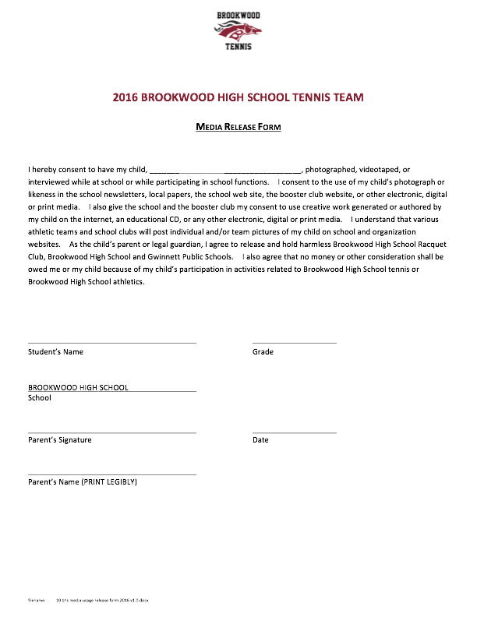
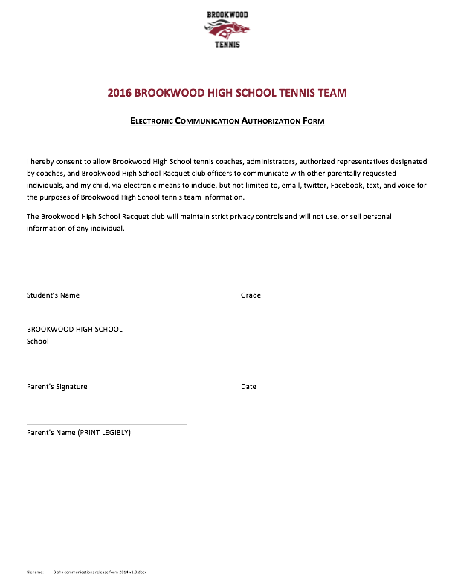
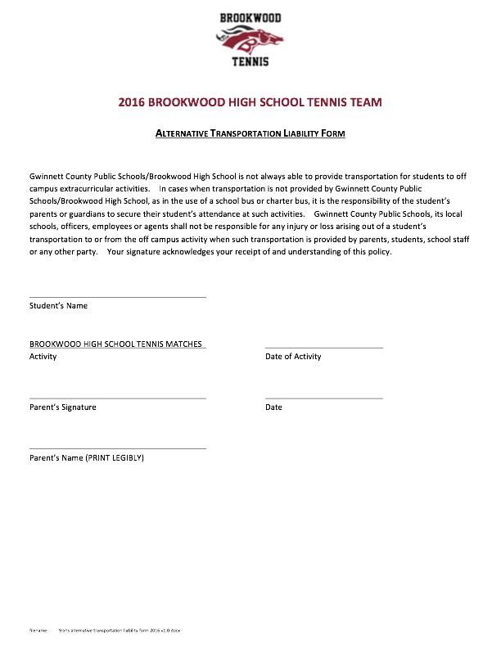
Forms - Releases

Slide 31
New Player Breakout

Slide 32
Key Dates
January 27 6:30pm Kickoff Meeting – Media Center
TBD Pictures
February 18th First matches JV
Canceled Deco Turf (Chattanooga) - Varsity
March 26 Senior Night (all teams) – Rhodes Jordan
April 5 - 9 Spring Break
April 9-10 Regions Semifinals and Finals
May 8 State Tournament
May ? Banquet
Go to brookwoodtennis.com
for all information

Slide 33
Budget | Overview
2021 Priorities
Enable 2021 teams to compete for championships in Region, in Georgia and in elite high school tournaments
Allow BHS Tennis players to represent our school and community with confidence

